Slide 1
Team 3
McBurnett, Kyle
Kim, Mi Yon
Tolleson, Chad M.
Cherukuri, Avinash Varma

Slide 2
Collaboration
52
Sprint 2 Commits
13%
More Commits
from Sprint 1
98
Project Commits
46
Sprint 1 Commits

Slide 3
Collaboration
28
Sprint 2 Push Requests
133%
More Push Requests
from Sprint 1
40
Project Push Requests
12
Sprint 1 Push Requests

Slide 4
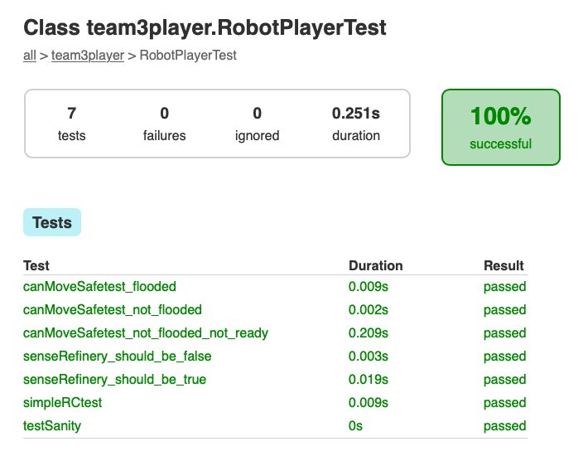
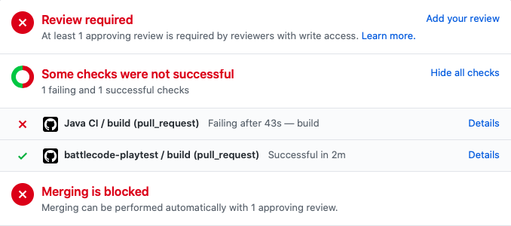
Unit Testing
Unit Testing forces Functions to be simple
( Complexity Down )
Tested functions can be built upon
( Increasing ReUse)

Slide 5
Sprint 2 Strategy
Priority 1
Get All Units Running
Priority 2
Build a Better Miner
Priority 3
Build a Wall
Priority 4
Use BlockChain Effectively

Slide 6
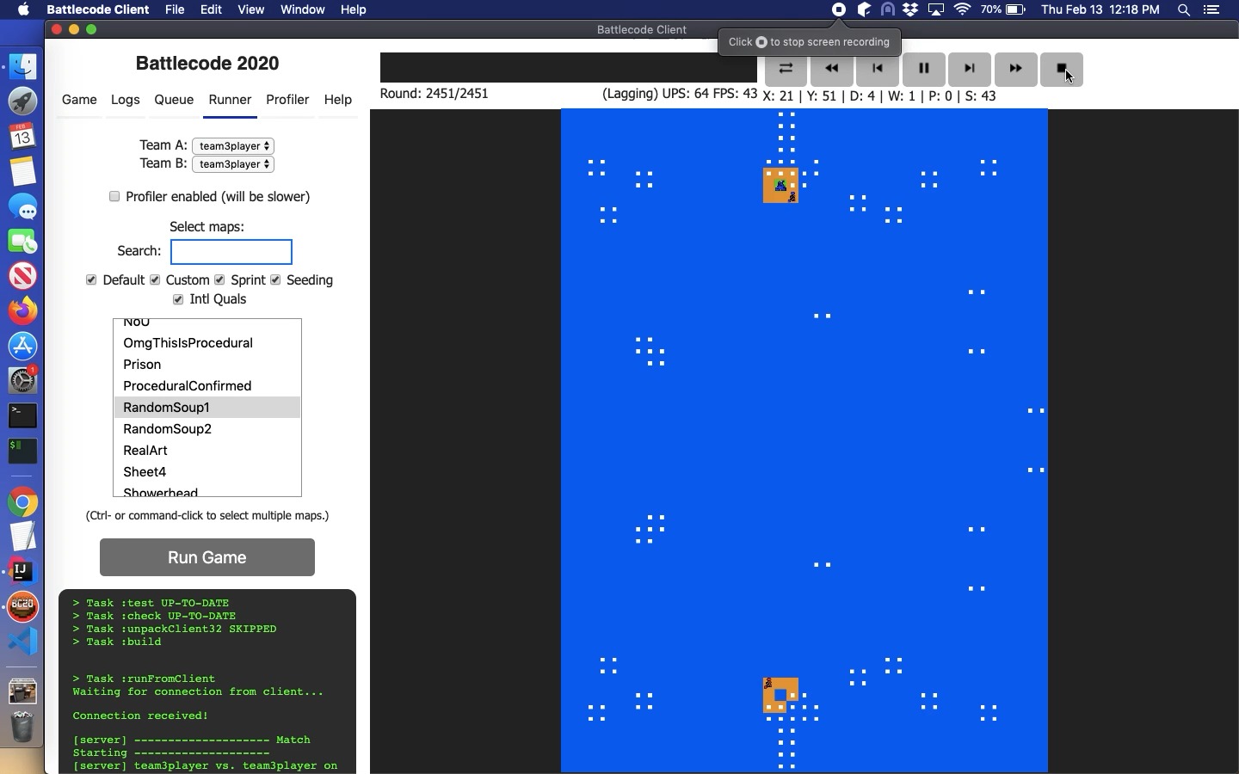
Game Play

Slide 7
Room to Explore
Check weather each Unit is getting properly
Deployed or not.
Check weather each Unit is working as
Intendedly or not.
Improving and Working on our Game Strategies

